Slide 1

Introduction to Natural Language Processing
Paul Rad, Ph.D.
Associate Professor
Cyber Analytics and AI
Information Systems and Cyber Security
College of Business School
210.872.7259

Slide 2
Outline
What is NLP
Application of NLP
What are the challenges?
Key NLP components

Slide 3
What is NLP
Natural language processing (NLP) is a field of computer science, artificial intelligence, and computational linguistics concerned with the interactions between computers and human (natural) languages. – Wikipidia

Slide 4
What to Read?
Natural Language Processing ACL, NAACL, EACL, EMNLP, CoNLL, Coling, TACL aclweb.org/anthology
Machine learning ICML, NIPS, ECML, AISTATS, ICLR, JMLR, MLJ
Artificial Intelligence AAAI, IJCAI, UAI, JAIR

Slide 5
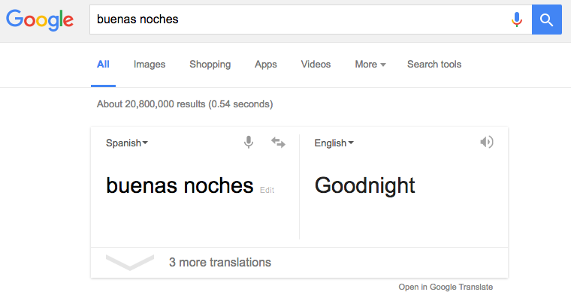
Machine translation

Slide 6
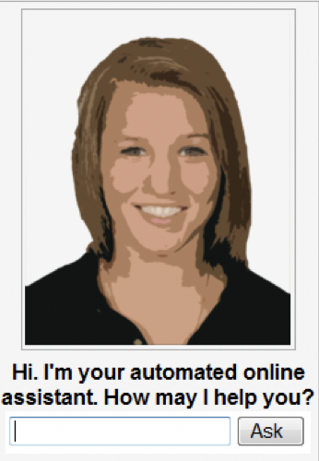
Dialog Systems

Slide 7
Sentiment

Slide 8

Language model applications
Autocomplete

Slide 9
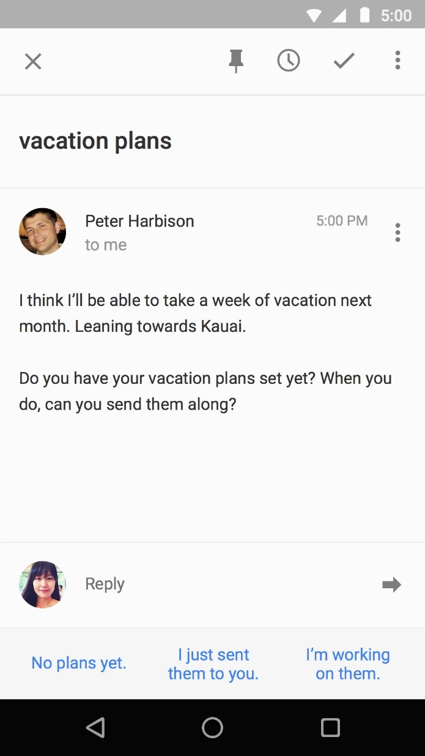
Language model applications
Smart Reply

Slide 10
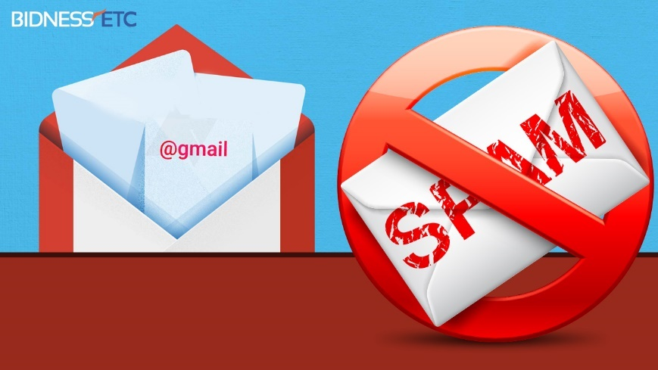
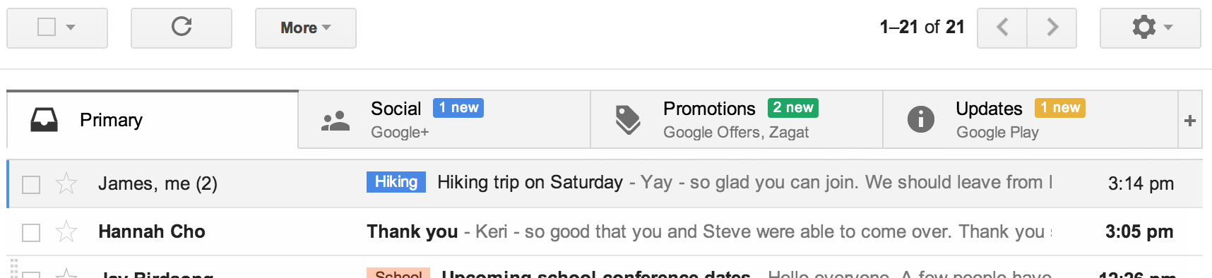
Text Classification
Phishing
www.wired.com

Slide 11
Question answering
'Watson' computer wins at 'Jeopardy'

Slide 12
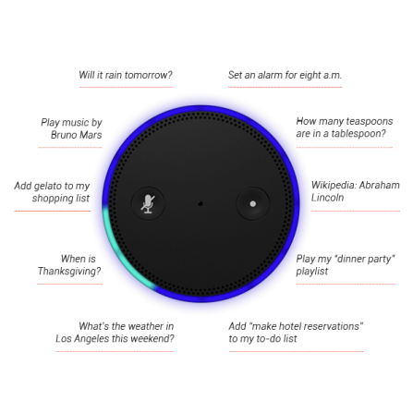
Natural language instruction
https://youtu.be/KkOCeAtKHIc?t=1m28s

Slide 13
Language Comprehension
Q: who wrote Winnie the Pooh?
Q: where is Chris lived?
Christopher Robin is alive and well. He is the same person that you read about in the book, Winnie the Pooh. As a boy, Chris lived in a pretty home called Cotchfield Farm. When Chris was three years old, his father wrote a poem about him. The poem was printed in a magazine for others to read. Mr. Robin then wrote a book

Slide 14
What are the challenges?
Paul Rad, Ph.D.
Associate Professor
Cyber Analytics and AI
Information Systems and Cyber Security
College of Business School
210.872.7259

Slide 15
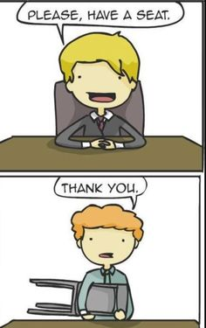
Challenges – ambiguity
Word sense ambiguity

Slide 16
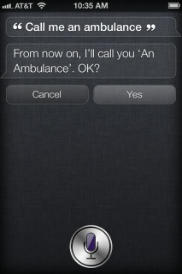
Challenges – ambiguity
Word sense / meaning ambiguity
Credit: http://stuffsirisaid.com

Slide 17
Challenges -- ambiguity
Ambiguous headlines:
Include your children when baking cookies
Local High School Dropouts Cut in Half
Hospitals are Sued by 7 Foot Doctors
Iraqi Head Seeks Arms
Safety Experts Say School Bus Passengers Should Be Belted
Teacher Strikes Idle Kids

Slide 18
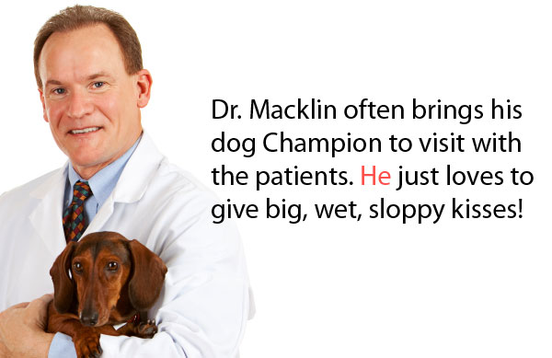
Challenges – ambiguity
Pronoun reference ambiguity
Credit: http://www.printwand.com/blog/8-catastrophic-examples-of-word-choice-mistakes

Slide 19
Challenges – language is not static
Language grows and changes
e.g., cyber lingo
LOL | Laugh out loud
G2G | Got to go
BFN | Bye for now
B4N | Bye for now
Idk | I don’t know
FWIW | For what it’s worth
LUWAMH | Love you with all my heart

Slide 20
Challenges – scale
Examples:
Bible (King James version): ~700K
Penn Tree bank ~1M from Wall street journal
Newswire collection: 500M+
Wikipedia: 2.9 billion word (English)
Web: several billions of words

Slide 21
Part of Speech Tagging
https://www.nltk.org

Slide 22
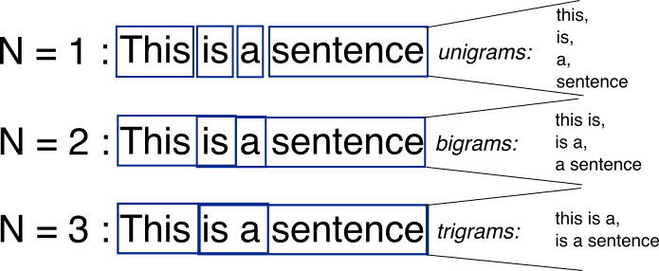
Bag-of-Words with N-grams
N-grams: a contiguous sequence of n tokens from a given piece of text
N-(N-grams -1)
http://recognize-speech.com/language-model/n-gram-model/comparison

Slide 23
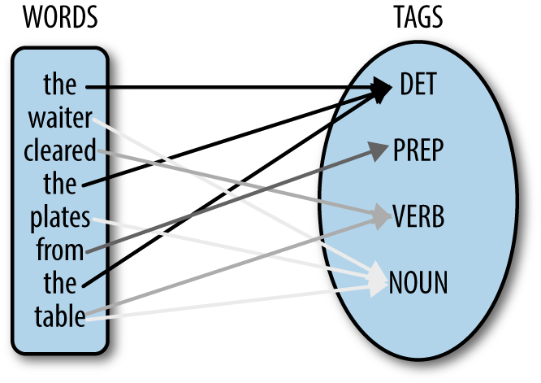
Part of Speech Tagging
part-of-speech tagging (POS tagging or PoS tagging or POST is the process of marking up a word in a text based on both its definition and its context—i.e., its relationship with adjacent and related words in a phrase, sentence, or paragraph. A simplified form of this is commonly taught to school-age children, in the identification of words as nouns, verbs, adjectives, adverbs, etc.

Slide 24
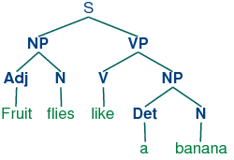
Syntactic parsing

